Slide 1



Fritsch-Asherman’s Syndrome ( AS)
Dr Muhammad M Al Hennawy Ob/gyn consultant Egypt mmhennawy.site44.com

Slide 2
Asherman syndrome is a debatable topic in gynaecological field and
There is no clear consensus about management and treatment
Asherman's syndrome is an uncommon, acquired, gynecological disorder

Slide 3
Histoty
Although the first case of intrauterine adhesion was published in 1894 by Heinrich Fritsch,
In 1948 , a full description of Asherman syndrome (AS) was carried out by Israeli gynaecologist Joseph Asherman at journal of obestetric and gynecology of the British Empire.

Slide 4
Synonyms or Alternate Spellings
Asherman's Syndrome
Fritsch Syndrome
Fritsch-Asherman's Syndrome
Intrauterine scarring
Intrauterine synechiae
Uterine synechiae
Intrauterine adhesions (IUA)
Intrauterine adhesion bands
Uterine/cervical atresia
Traumatic uterine atrophy
Sclerotic endometrium,
Endometrial sclerosis

Slide 5
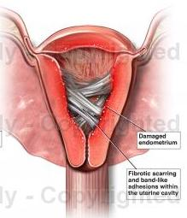
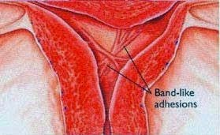
Definition
It is an an infrequently acquired uterine condition,
characterized by the bands of fibrous tissue (scar tissue)
inside the uterine cavity and/or endocervix.
usually secondary to intrauterine surgery or infection

Slide 6
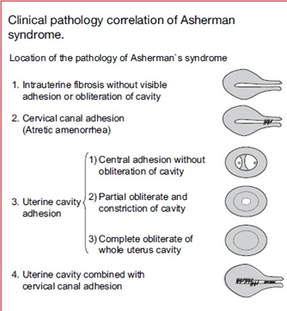
Types
1- Intrauterine fibrosis without visible adhesion or obliteration of the cavity (Unstuck Asherman's or endometrial sclerosis )
2- Cervical canal adhesion ( Atretic amenorrhea )
3-Uterine cavity adhesion
a-central adhesion without obliteration of the cavity
b- partial obliteration and constriction of the cavity
c- complete obliteration of whole uterine cavity
4-Uterine cavity combined with cervical canal adhesion

Slide 7
Classification of adhesions
There is still no clear consensus regarding the optimum classification of AS.
None of proposed classification systems seems to offer a valuable reproductive prognosis, as a consequence,
Further studies are required

Slide 8
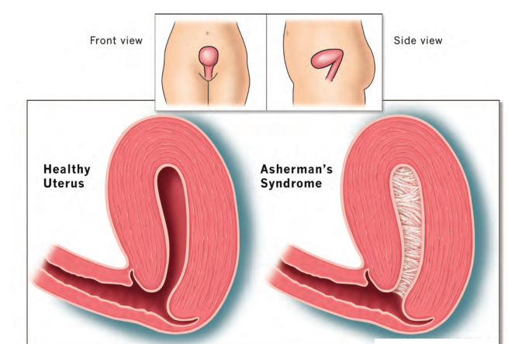
According To
Site of the adhesions
In many cases the front and back walls of the uterus stick to one another.
In other cases, adhesions only occur in a small portion of the uterus.
Extent of the adhesions
The extent of the adhesions defines whether the case is mild, moderate, or severe.
Type of the adhesions
The adhesions can be thin or thick, spotty in location, or confluent.
Vascularity of the adhesions
They are usually not vascular, which is an important attribute that helps in treatment

Slide 9
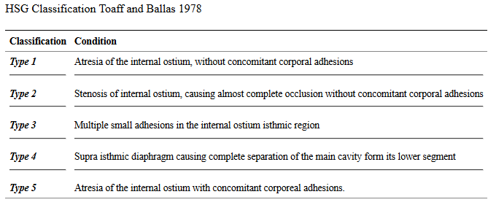
a – Toaff And Ballas Classification by HSG1978

Slide 10
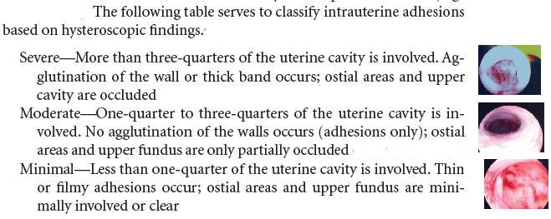
b – March Classification by hysteroscopy 1978

Slide 11
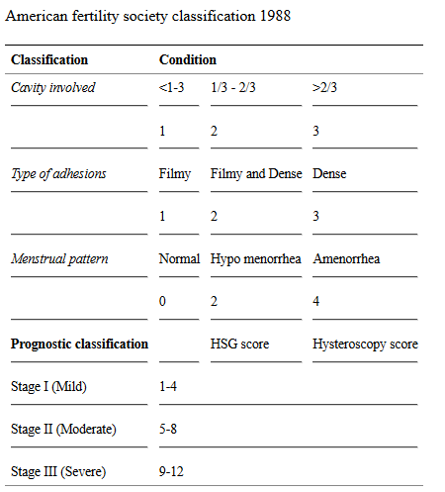
c - Classification by American Fertility Society 1988

Slide 12
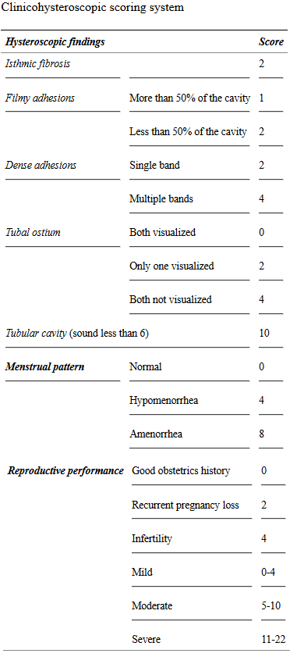
d - Classification by clinicohysteroscopy

Slide 13
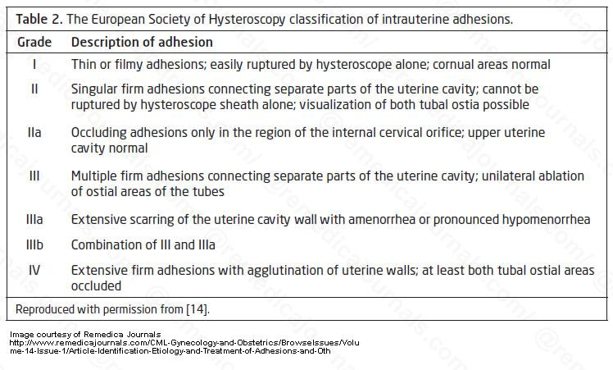
e -European Society Of Hysteroscopy

Slide 14
Unstuck Asherman's or endometrial sclerosis
There is a variant of Asherman's Syndrome called "Unstuck Asherman's or endometrial sclerosis that is more difficult to treat.
In this condition, which may coexist with the presence of adhesions, the uterine walls are not stuck together. Instead, the endometrium has been denuded.
Although curettage can cause this condition, it is more likely after uterine surgery, such as myomectomy.
In these cases the endometrium, or at least its basal layer, has been removed or destroyed.

Slide 15
Intended Asherman Syndrome
In patients with persistent excessive uterine bleeding (hypermenorrhea),
Specific procedures to create these adhesions throughout the uterine cavity is the desired goal to control the bleeding.
These procedures are done to ablate the endometrium and create the scarring.

Slide 16
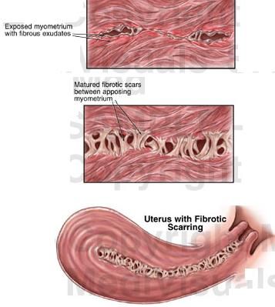
Pathophysiology of AS and IUA
Intrauterine adhesions result secondary to trauma to the basal layer of the endometrium with subsequent scarring
Electric microscopic evaluation of endometrial glandular cells of women affected by severe AS revealed significant sub-cellular modifications such as ribosome lost, mitochondria swelling vascular closure and hypoxic cellular modifications
The adhesions are composed of fibromuscular-connective tissue bands with or without surrounding superficial epithelial cells or glandular tissue.
An impaired vascularity of both endometrium and myometrium has been demonstrated by using pelvic angiography in patients with dense IUA

Slide 17
Causes
Damage to basilar layer of endometrium secondary to vigorous dilation and curettage (D&C) , retained placenta ,intrauterine myomectomy, cesarean delivery ,hystrescopic procedures , metroplasty , uterine artery embolisation , pelvic radiation or
Endometritis (infection , genital tuberculosis and schistosomiasis ) or
Hypogonadism
Although not clearly identified, a possible genetic factor could explain why certain patients show more frequent adhesions incidence and recurrence, or why IUA adhesions can develop even without any surgical trauma or trigger event

Slide 18
Incidence
The incidence of this pathology seems to be significantly influenced by the number of abortions performed, the high incidence of genital tuberculosis in some countries and the different criteria used to detect intrauterine adhesions.
Asherman's Syndrome is thought to be under-diagnosed
because it is usually undetectable by routine diagnostic procedures such as an ultrasound scan.

Slide 19
Asherman syndrome: summary of risk factors
Miscarriage curettage 66.7%
Postpartum curettage 21.5%
Caesarean section 2%
Trophoblastic disease evacuation 0.6%
Mullerian duct malformation 16%
Infection (Genital tuberculosis) 4%
Diagnostic curettage 1.6%
Abdominal myomectomy 1.3%
Uterine artery embolization 14
Hysteroscopic surgery:
• metroplasty 6%
• myomectomy (single myoma) 31.3%
• myomectomy (multiple myomas) 45.5%
• endometrial ablation 36.4%
Insertion of IUD 0.2%
Uterine compressive sutures for post-partum haemorrhage 18.5%

Slide 20
Symptoms
This fact may prove to be of clinical importance in patients with Asherman's Syndrome who experienced a loss of functional endometrium
Most patients with Asherman's Syndrome have menstrual disorders eg scanty ( hypomenorrhea ) or absent periods (amenorrhea) but some have normal periods.
Some patients have no periods but feel pain at the time that their period would normally arrive each month. This pain may indicate that menstruation is occurring but the blood cannot exit the uterus because the cervix is blocked by adhesions also cause retrograde menstruation which cause endometriosis.
The impact of the AS on pregnancy is well documented with a high rate of infertility, Recurrent miscarriage, poor implantation following in vitro fertilization , preterm labour , IUGR and abnormal placentation ( placenta previa , placenta accreta )

Slide 21

Diagnosis
AS cannot be diagnosed by simple bimanual pelvic examination,
Direct visualization of the uterus via Hysteroscopy is the most reliable method for diagnosis.
Other methods are sonohysterography (SHG)with 2D or 3D sonar and
Hysterosalpingogram (HSG).
MRI can be helpful as a supplementary diagnostic tool

Slide 22
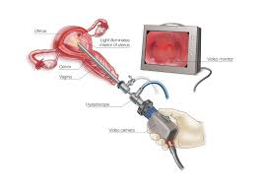
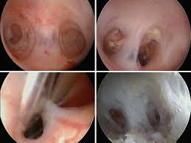
Hysteroscopy
Hysteroscopy remains the gold standard in the assessment of AS.
Hysteroscopy provides a real time view of the uterine cavity, allowing for a meticulous definition of the site, extent and character of any adhesions, and it is the optimum tool for assessing the endometrium.
Currently, this technique can be performed in ambulatory setting with less discomfort than a blind HSG. Hysteroscopy also makes immediate treatment possible in some favourable cases

Slide 23
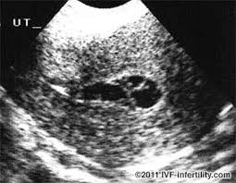
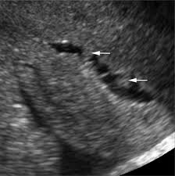
Sonohysterography
The use of saline infusion during the ultrasound scan (Sonohysterography or SHG) has also been investigated.
May be seen as hypoechoic bands traversing through the endometrial cavity

Slide 24
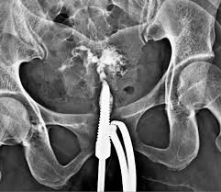
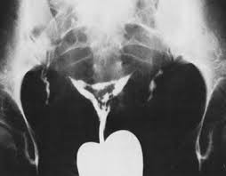
HCG
Historically, hysterosalpingography (HSG) has represented the most widespread diagnostic tool. It is a cost-effective method to assess tubal patency in women who suffer from infertility.
HSG (hysterosalpingogram) will typically demonstrate solitary, multiple filling defects, bands of tissue traversing endometrial cavity, non-distensability, irregularity of uterine cavity, partial or near obliteration of cavity
Usually, AS is characterized by filling defects described as homogeneous opacity surrounded by sharp edges
In the worst cases, the uterine cavity appears completely distorted and narrowed, and ostial occlusion may also be evident. However, the information provided by an HSG is relatively crude, and it is important to bear in mind that the investigation has a high false positive rate

Slide 25
Magnetic resonance imaging
(MRI) can be helpful as a supplementary diagnostic tool, especially when the adhesions involve the endocervix. IUA are visualized as low signal intensity on T2 weighed-image inside the uterus

Slide 26
Differential Diagnosis
Causes of secondary amenorrhea
Causes of pelvic pain
Causes of infertility
Causes of abortion
Causes of preterm labour
Causes of IUGR
Causes of placenta accretta
On a hysterosalpingogram consider:
normal intrauterine longitudinal folds in a non-distended uterus may sometimes mimic uterine synechiae ⁴
amniotic sheets: uterine synechiae occurring in pregnancy
amniotic band syndrome
intrauterine membrane in pregnancy

Slide 27
Prevention
Ideally, prevention is the best solution.
It was suggested as early as in 1993 ⁻⁻ that the incidence of intrauterine adhesions (IUA) might be lower following medical evacuation (eg., misprostol) of the uterus, thus avoiding any intrauterine instrumentation.
Alternatively, D&C could be performed under ultrasound guidance rather than blindly. This would ensure that the surgeon stops scraping the lining when all retained tissue has been removed, thereby avoiding injury.
Early monitoring during pregnancy to identify early miscarriage can prevent the development of, or as the case may be, the reoccurrence of Asherman's Syndrome as adhesions are more likely to occur after a D&C the longer the period after fetal death Therefore, immediate evacuation following fetal death may prevent IUA.
There is no evidence to suggest that suction D&C is less likely to result in adhesions than sharp D&C. Cases of Asherman's Syndrome have been reported even following manual vacuum aspiration

Slide 28
The Goal Of Therapy
It is to remove adhesions and
Subsequently restore
The normal size and
Shape of the uterine cavity.

Slide 29
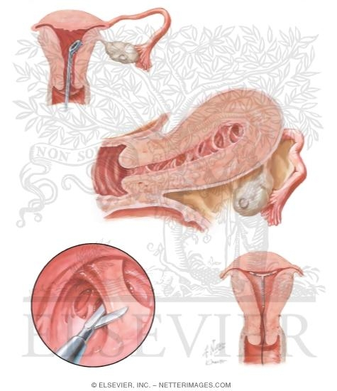
Management and treatment of Asherman syndrome
The treatment strategy of AS could be summarized in four main steps:
1. Treatment (Dilatation and curettage, hysteroscopy, hysterotomy)
2. Re-adhesion prevention (Intrauterine device, Uterine balloon stent, Foley’s catheter, anti-adhesion barriers)
3. Restoring normal endometrium (Hormonal treatment, stem cells)
4. Post-operative assessment (Repeat surgery; diagnostic hysteroscopy; ultrasound).

Slide 30
1 - Treatment
Hysteroscopy,
Dilatation and curettage,
Hysterotomy

Slide 31
Hysteroscopic surgery
Adhesiolysis done using hysteroscopic scissors.
Hysteroscopic surgery has revolutionized the treatment of intrauterine adhesion and it is the established gold standard technique. The magnification and the direct view of the adhesions allow for a precise and safe treatment. When the lesions are filmy, the tip of the hysteroscope and uterine distension may be enough to break down the adhesions
Thus, in favourable cases the restoration of cavity can be obtained through “no touch” hysteroscopy in out-patient setting without general anaesthesia.
According to many experts, the removal of the adhesions should start form the lower part of the uterus and progress toward the upper part
Any central and filmy adhesions should be separated initially in order to allow adequate distension of the uterine cavity.
Dense and lateral adhesions should be treated at the end, bearing in mind the greater risk of uterine perforation and bleeding

Slide 32
Dilatation and curettage
Before the introduction of hysteroscopy, the blind dilation and curettage (D&C) was the treatment of choice
Nevertheless blind D&C is associated with a high risk of uterine perforation as well as being a relatively poor diagnostic tool, with the result that this technique should be considered obsolete

Slide 33
Hysterotomy
Few cases of AS treatment using an open-surgery approach with transfundal separation of scarring uterine walls have been mentioned: in some cases an adequate restoration of menstruation and fertility was obtained
It has been superseded by hysteroscopic techniques, so today this strategy may be adopted only in extremely complex situation, when the hysteroscopic approach is not possible or unlikely to succeed, and only by expert surgeons
The patient should be informed about the risk of the procedure, and warmed that the successful restoration of the cavity may not be obtained, not even with such an aggressive approach

Slide 34
2. Re-Adhesion Prevention
Intrauterine device,
Uterine balloon stent,
Foley’s catheter,
Anti-adhesion barriers ( Hyaluronic acid and other anti-adhesion barriers )

Slide 35
IUD
The rate of IUA reformation after surgery remains high (3.1% to 23.5%)
These adhesions usually tend to be thin and filmy
The use of IUD in order to prevent adhesion recurrence
In IUD could help physiological endometrial regeneration by separating the anterior and posterior uterine walls.
the Lipples loop was considered the most adequate device to prevent adhesion albeit it is no longer available in the global market

Slide 36
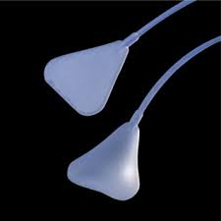
Intrauterine Balloon Stent
A new intrauterine stent was also described as a mechanical method to prevent adhesions recurrence
It is a silicon made, triangular shape device which fits the normal triangular shape of the uterine cavity

Slide 37
Pediatric Foley catheter
The Pediatric Foley catheter was one of first mechanical devices used to separate the uterine walls preventing the recurrence of the IUA for 1 week

Slide 38
Hyaluronic Acid
Hyaluronic acid is one of the most widespread component in human tissue and it is involved in many biological function such as mechanical support, cell migration and proliferation.
In the last decades, products derived from hyaluronic acid have been adopted in gynaecologic surgery to prevent both intraperitoneal and intrauterine adhesions
the mechanism by which these products act is not completely understood.
Hyaluronic acid generates a temporary barrier between organs which mechanically obstacles adhesions formation; in addition, these products influence peritoneal tissue repair by increasing the proliferation rate of mesothelian cells

Slide 39
Another Anti-Adhesion Barrier
It is characterized by chemically modified hyaluronic acid (sodium hyaluronate) and carboxymethylcellulose (Seprafilm) was used for prevention of IUA

Slide 40
3 - Restoration of normal endometrium
Hormonal treatment, stem cells

Slide 41
Medical therapy
Many different treatments have been suggested and there is no shared consensus about the time of the administration (preoperative and/or postoperative) and the type of regimen (oestradiol or combined oestradiol and progesterone). The general idea is to encourage fast growth of any residual endometrium immediately after surgery with the dual purpose of preventing new scar formation and restoring a normal uterine environment. It is supposed that this goal can only be achieved with supraphysiological hormonal levels.
he use of sildenafil citrate intravaginally was documented as possible pharmacological treatment to restore endometrial thickness. This drug is a type 5 specific phosphodiesterase inhibitor that enhances vasodilator effect of nitric oxide (NO) whose synthase isoforms were also found in the uterus
In a prospective observational study, sildenafil citrate improved endometrial thickness in 92% of cases who presented thin endometrium (endometrial thickness <8 mm)

Slide 42
Stem Cells
Endometrial tissue had an intrinsic capacity of regeneration. Endometrial regeneration normally occurs after menstruation and delivery. There is substantial evidence in literature that adult endometrial tissue contains epithelial progenitor cells and mesenchymal/stromal (MSC) cells
These cells could be the target of a specific therapy in order to regenerate the endometrial tissue in cases of dysfunctional or atrophic endometrium.
Recently, a case report of a severe AS treated with autologous stem cells isolated from the women’s own bone marrow has been described

Slide 43
Fresh Platelet Rich Plasma (PRP)
Intrauterine infusion of freshly prepared PRP if endometrial lining less than 7 mm
with estrogen orally E2 12 mg for 10 day
And repeat PRP after 72 hour if endometrial thickness less than 7 mm

Slide 44
4-Post-operative assessment
Evaluation of uterine cavity after adhesiolysis is an important step in AS management. As mentioned before, complete resolution of the adhesions is not always possible with a single procedure, especially in severe stages where a high recurrence rate is documented.
Ultrasound is an accurate and cost-effective tool for measuring endometrial thickness and for the evaluation of normal endometrial development during menstrual cycle.
HSG has the advantage to check tubal patency, and at the same time it can help in the resolution of thin adhesions from pressure of the liquid contrast medium.
Hysteroscopy, however, remains the only method which allows an accurate estimation of adhesion recurrence and it is the most commonly used in clinical practice. Of course, it also allows further in office adhesiolysis.
To be done up to 12 weeks

Slide 45
Non Reproductive Consequences of Asherman’s Syndrome
The reproductive consequences of Asherman’s Syndrome, including
infertility,
recurrent miscarriage,
Incomptent cervix
intrauterine growth restriction,
placenta accreta and
others, are well known. However, for all women with intrauterine scarring and amenorrhea,
including those who may have completed childbearing, there are other concerns.
Although the lack of menstrual periods could be secondary to hormonal abnormalities, it is more likely caused by either complete destruction of the uterine lining or by obstruction of the cervix or lower portion of the uterus; thus, menses are either retained in the uterus (leading to pelvic pain and a condition called hematometra) or flow into the abdominal cavity leading to endometriosis.
Women with Asherman’s Syndrome may develop uterine cancer, either before or after menopause.

Slide 46
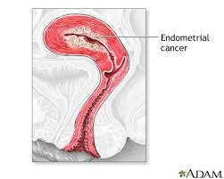
Endometrial Cancer
although the risk of endometrial cancer in women with Asherman syndrome may be lower than the general population, women with Asherman may develop endometrial cancer before or after menopause. Since the signs and symptoms often found in these women (early or abnormal bleeding, thickened endometrium) may be missed due to the scarring or cervical obstruction. Therefore, these women may benefit from routine sonographic evaluation of the endometrium to monitor changes.

Slide 47
Prognosis
The extent of adhesion formation is critical.
Mild to moderate adhesions can usually be treated with success.
Extensive obliteration of the uterine cavity or fallopian tube openings (ostia) and deep endometrial or myometrial trauma may require several surgical interventions and/or hormone therapy or even be uncorrectable.
If the uterine cavity is adhesion free but the ostia remain obliterated, IVF remains an option.
If the uterus has been irreparably damaged, surrogacy or adoption may be the only options

Slide 48
It is mandatory to verify that
the uterus has healed
before recommending that a patient attempt to conceive;
this verification may be done by
another HSG, saline ultrasound or hysteroscopy
in the doctor’s office.

Slide 49
Conclusions
AS is a condition with a high impact on female reproduction.
Even in women who conceive after AS treatment, a scrupulous surveillance should be carried out for the high risk of placental anomalies and much effort should be devoted to the prevention.
The introduction of hysteroscopy has significantly improved the fertility outcome and the treatment success rate
Nevertheless, AS recurrence rates remain high, and we must continue to look for techniques which reduce the formation of new adhesions.

